Slide 1
Artificial Intelligence
Machine Learning Deep Learning
Yapay Zeka Yaz Atölyesi
Batuhan Düzgün
2018

Slide 2

Learning?
“Learning is any process by which a system improves performance from experience.”
–Herbert Simon

Slide 3
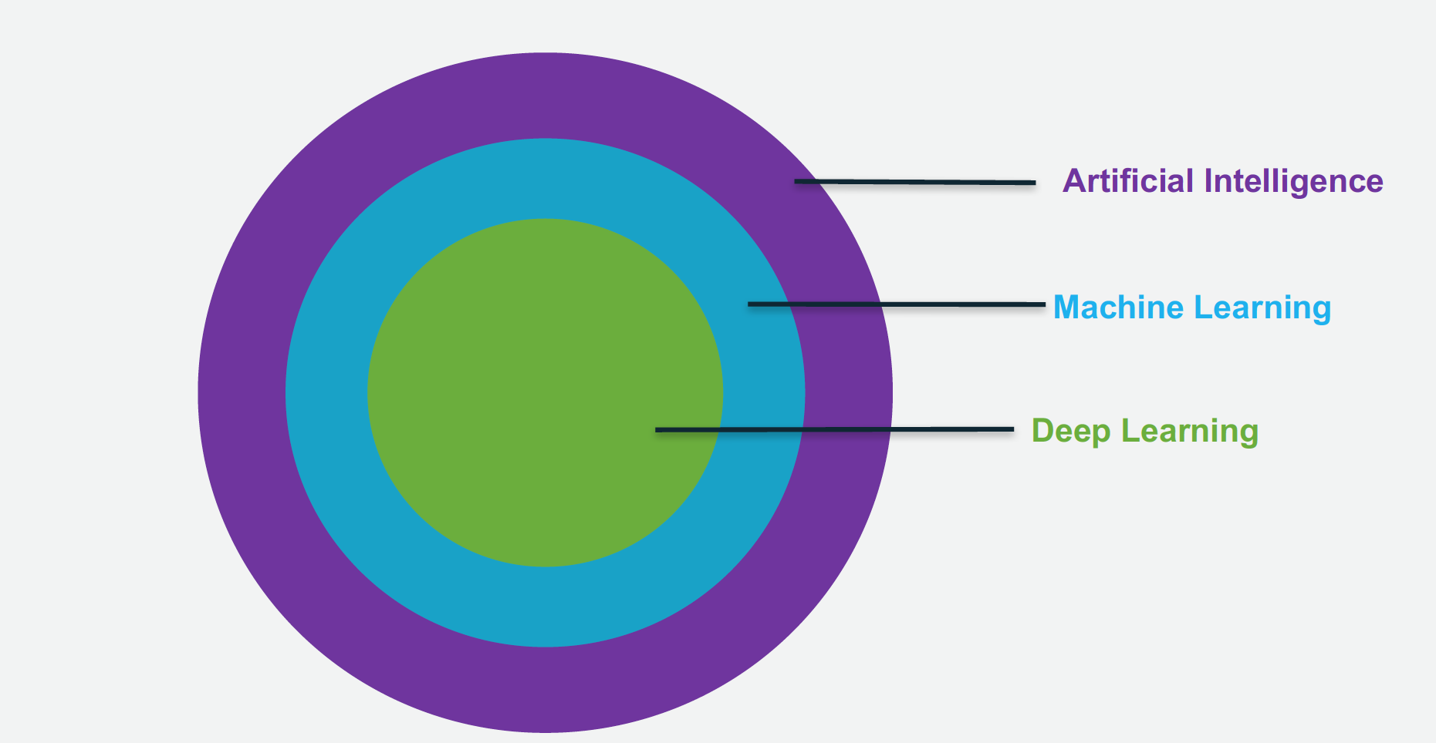
Learning?

Slide 4
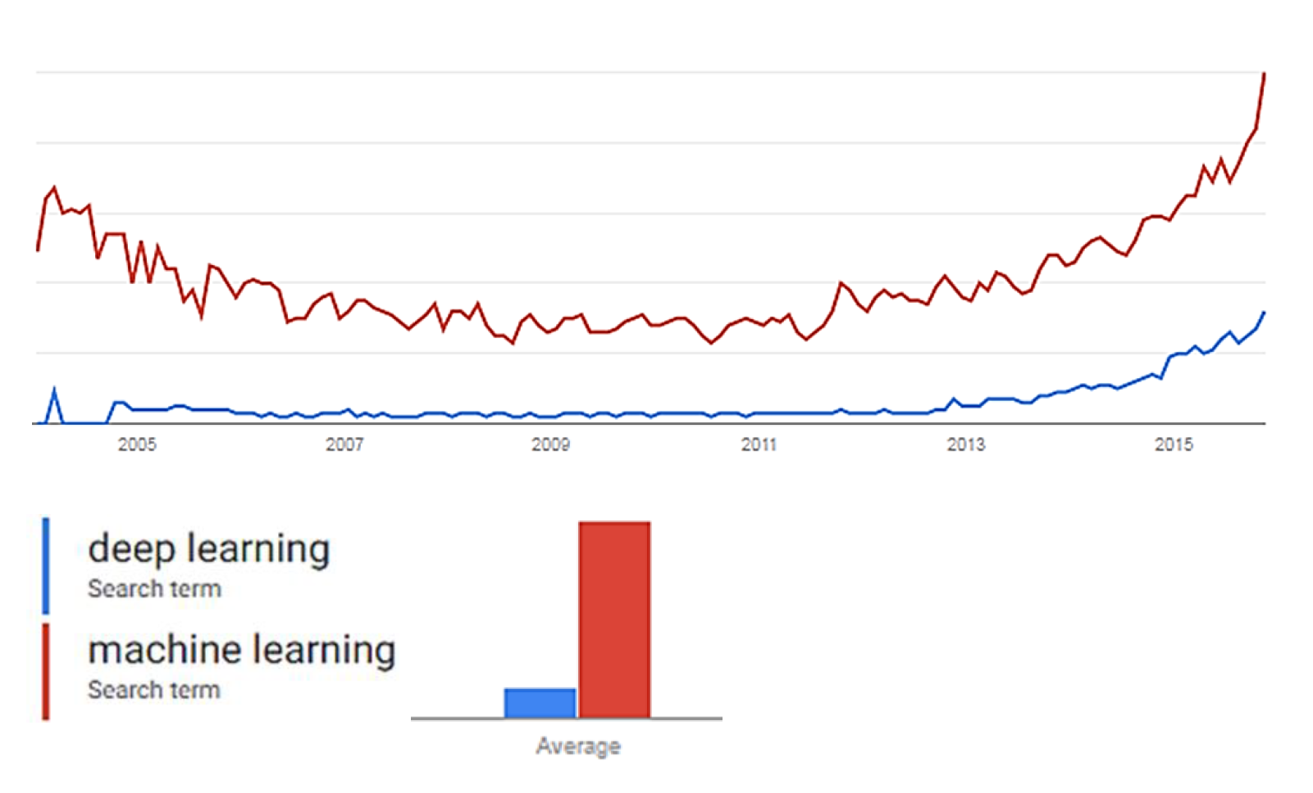
Hype or Reality?

Slide 5
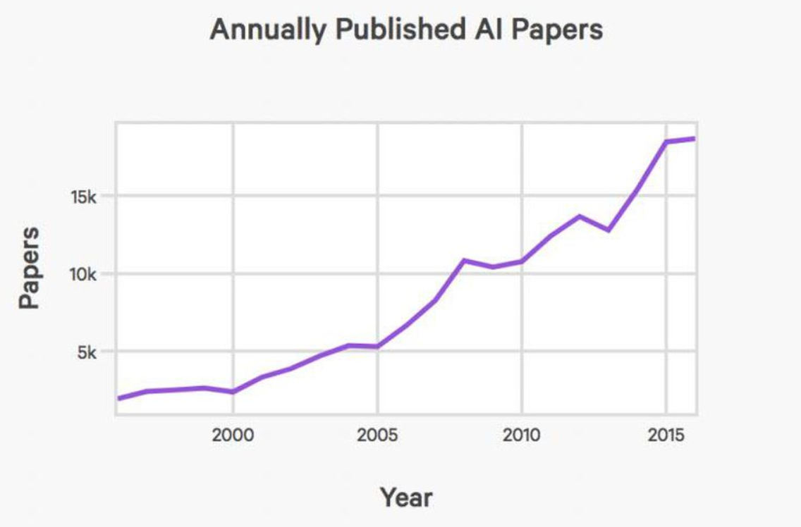
Hype or Reality?

Slide 6
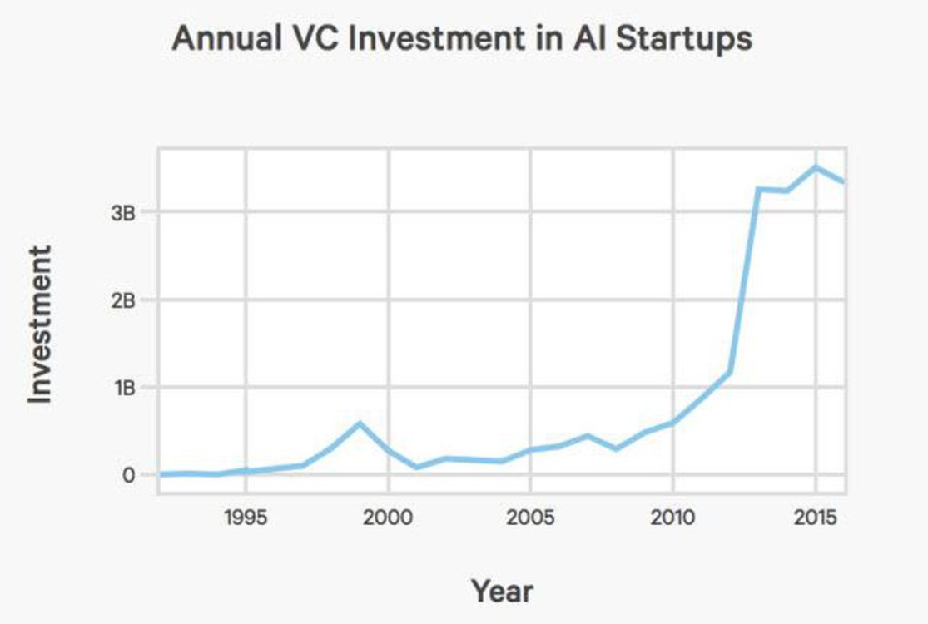
Hype or Reality?

Slide 7
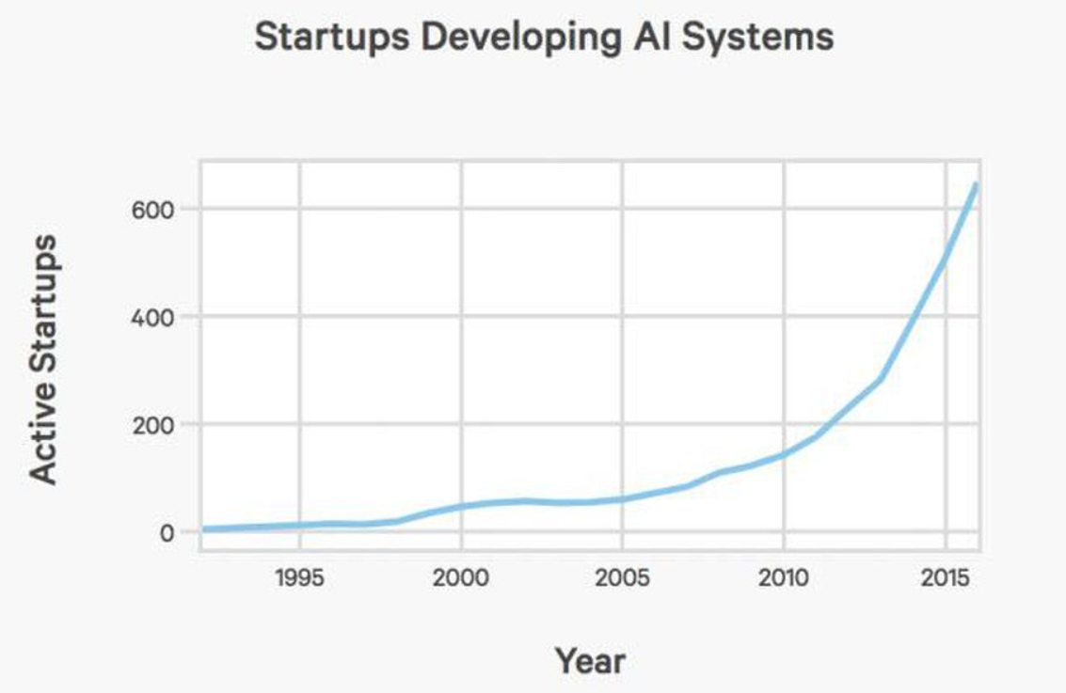
Hype or Reality?

Slide 8
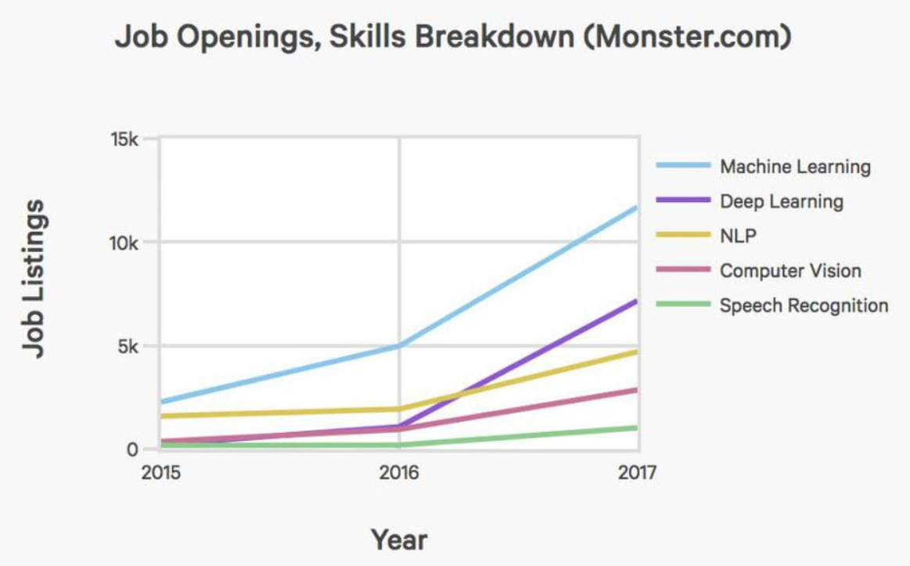
Hype or Reality?

Slide 9
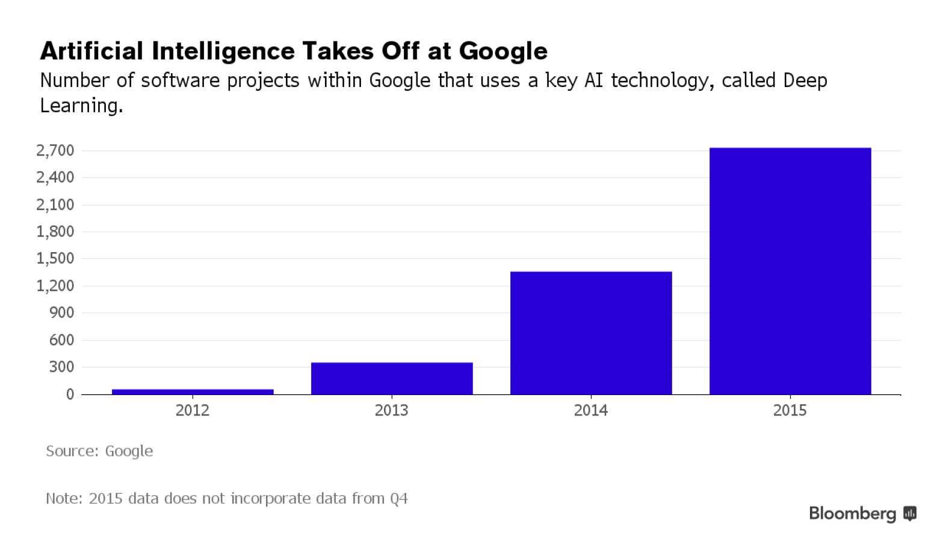
Hype or Reality?

Slide 10
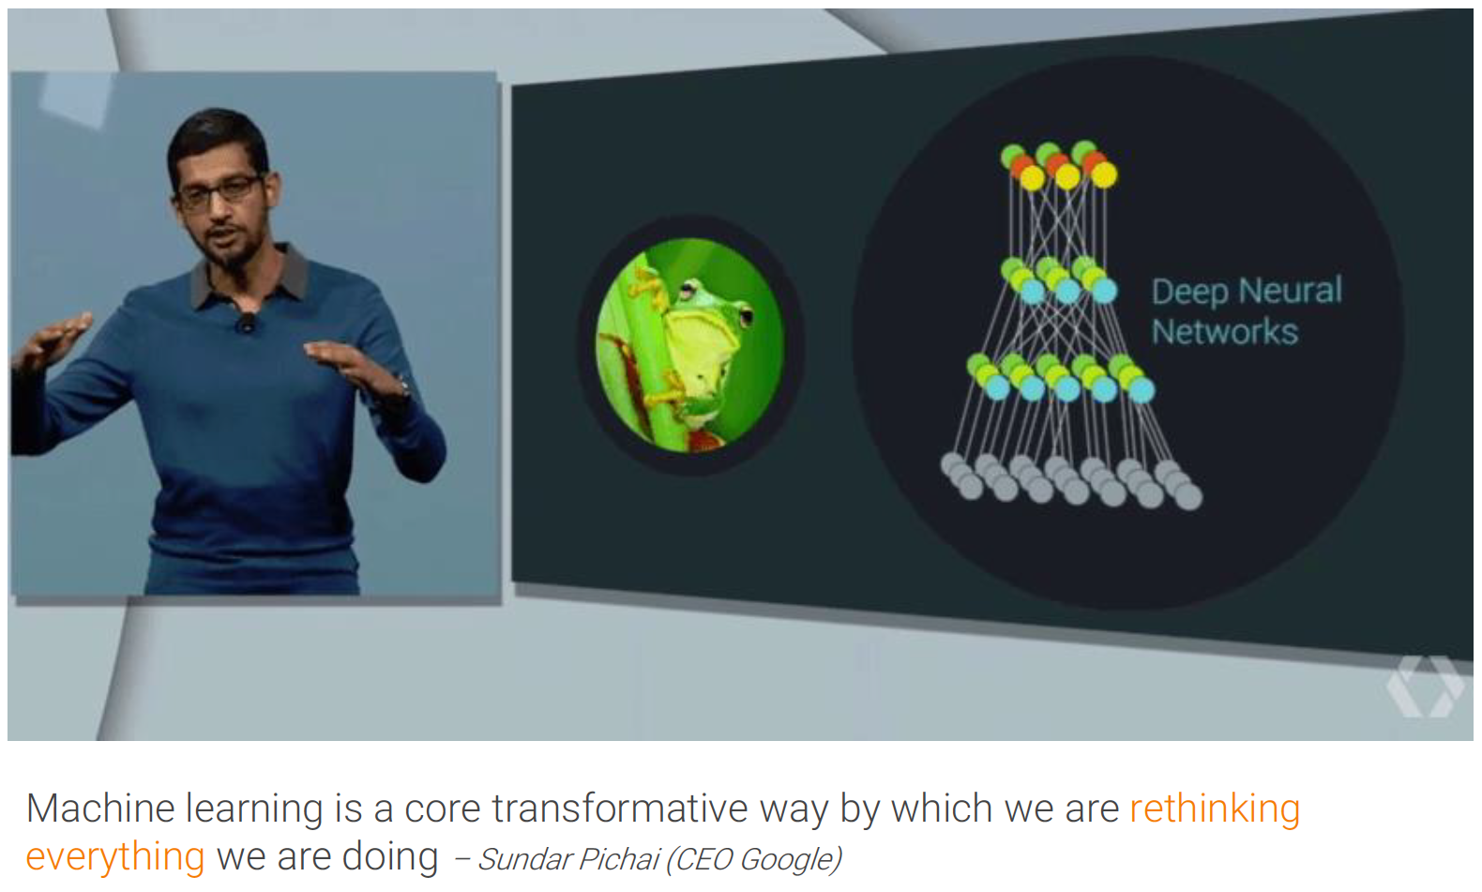
Hype or Reality?
Google

Slide 11
The History of AI
Maturation of Artificial Intelligence (1943-1952)
The birth of Artificial Intelligence (1952-1956)
The golden years-Early enthusiasm (1956-1974)
The first AI winter (1974-1980)
A boom of AI (1980-1987)
The second AI winter (1987-1993)
The emergence of intelligent agents (1993-2011)
Deep learning, big data and artificial general intelligence (2011-present)
Notes:
1950: Alan Turing publishes "Computing Machinery and Intelligence”
1956: The word "Artificial Intelligence" first adopted by American Computer scientist John McCarthy
1966: first chatbot in 1966, which was named as ELIZA.
1980: AI came back with "Expert System”
1997: IBM DeepBlue
2006: Facebook, Google investments
2011: IBM's Watson won jeopardy, a quiz show
2014: Chatbot "Eugene Goostman" won a competition in the infamous "Turing test.”
2018: Google has demonstrated an AI program "Duplex" which was a virtual assistant

Slide 12
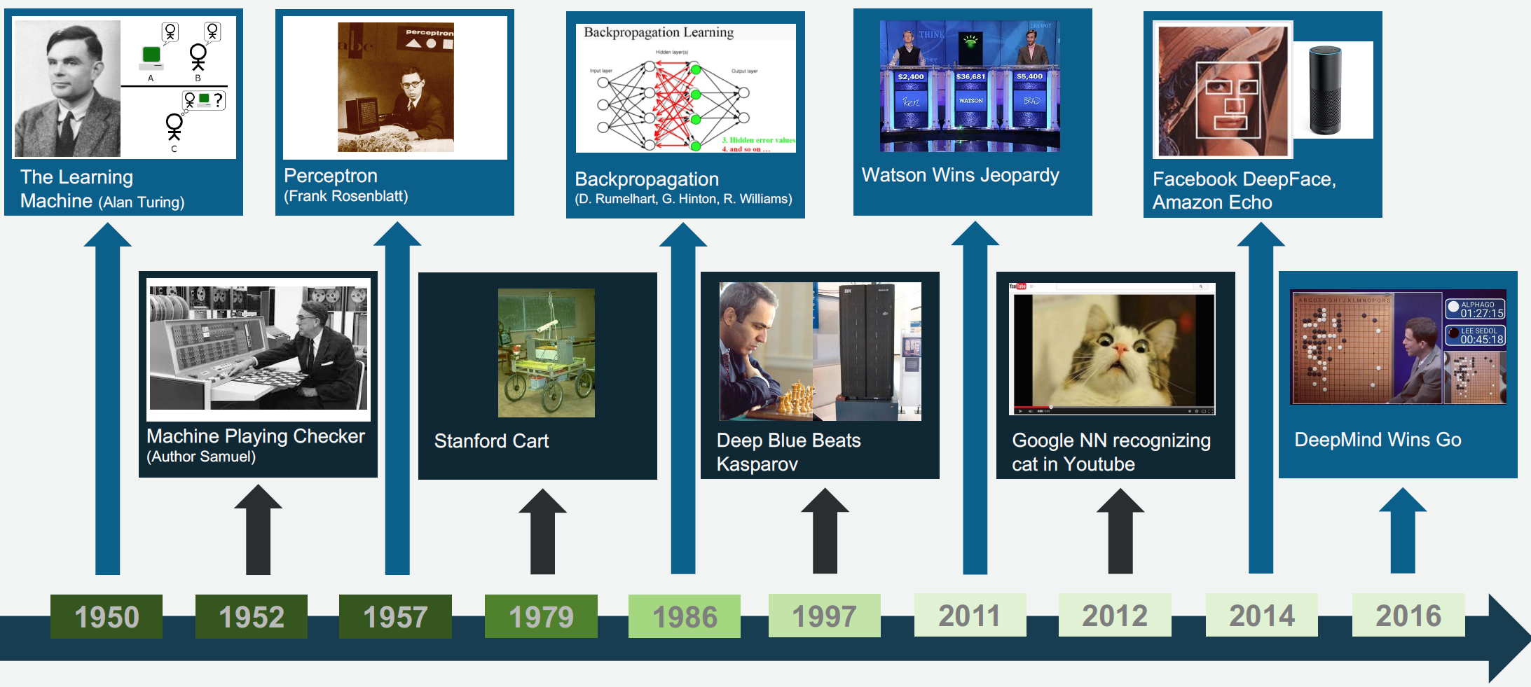
The History of AI

Slide 13
The History of AI
https://ahistoryofai.com/

Slide 14
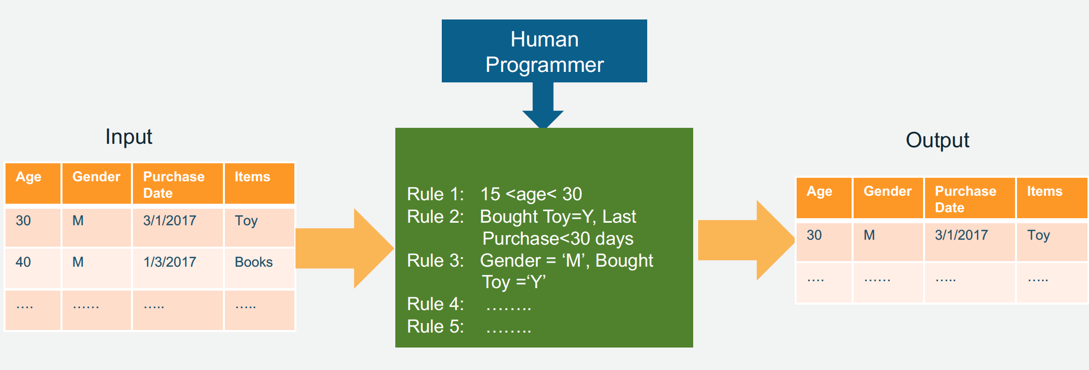
Machine Learning?

Slide 15
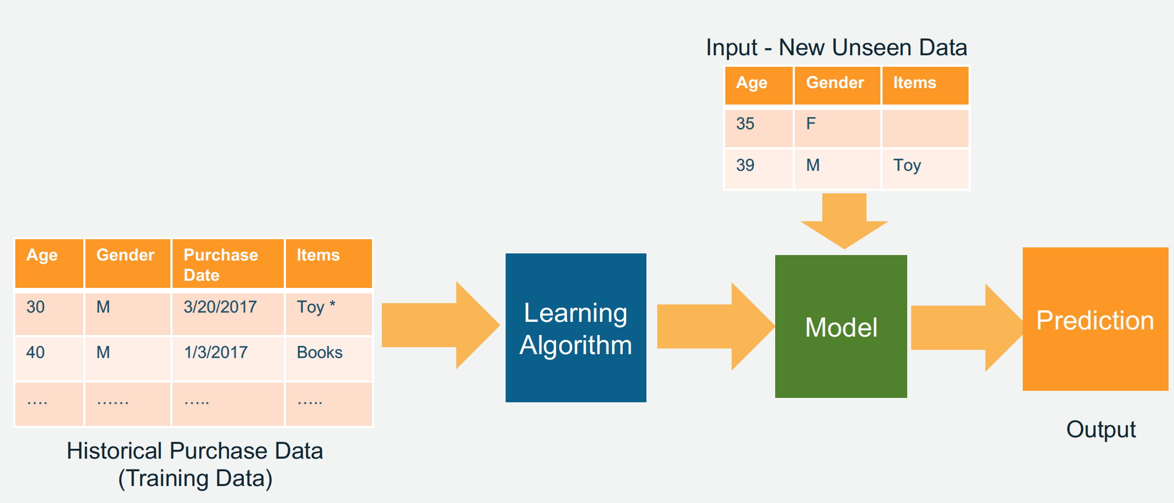
Machine Learning?

Slide 16
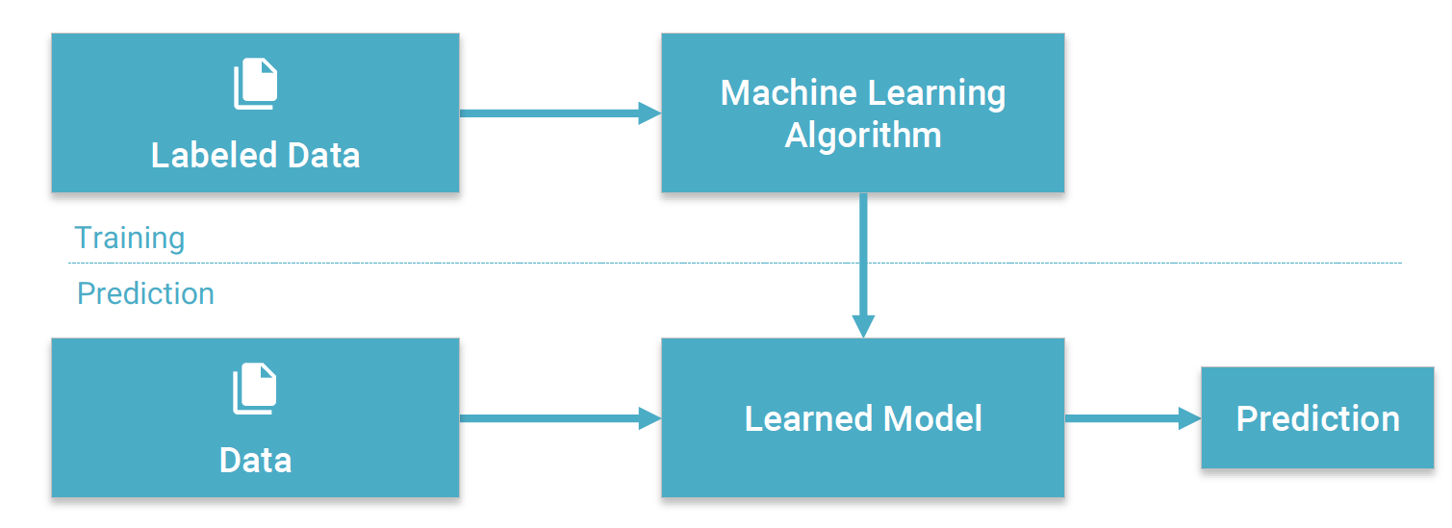
Machine Learning?

Slide 17
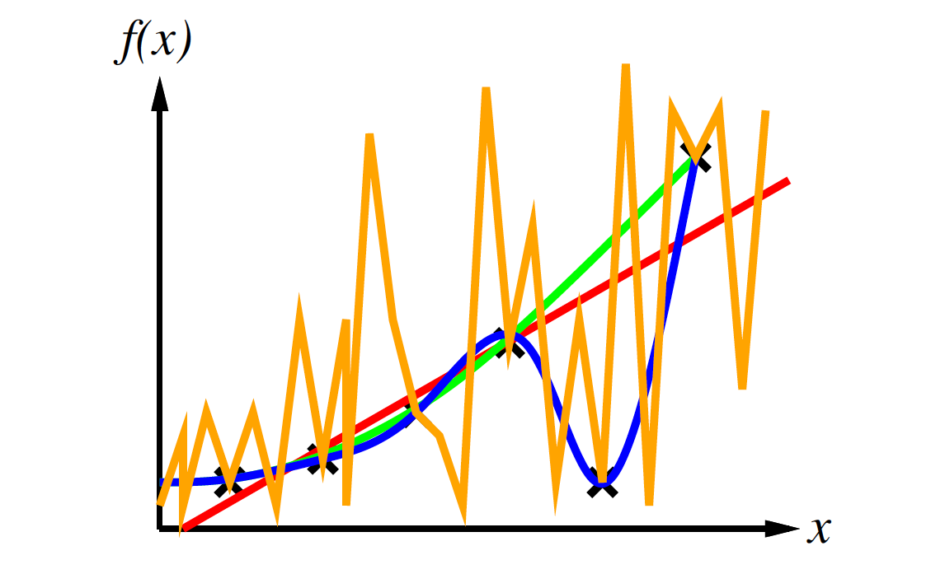
Machine Learning?

Slide 18
Ockham’s Razor
“maximize a combination of consistency and simplicity”

Slide 19
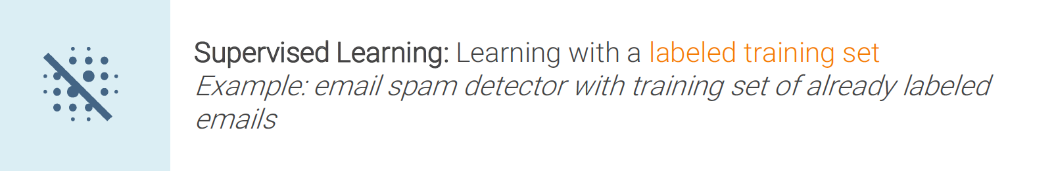
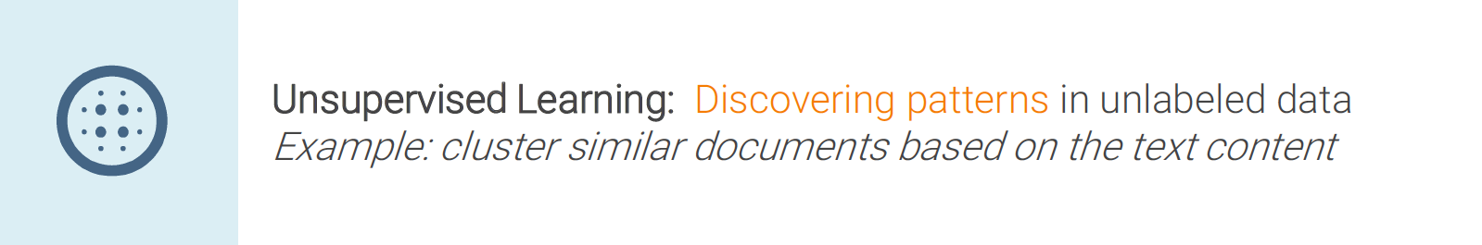

Learning Approaches

Slide 20
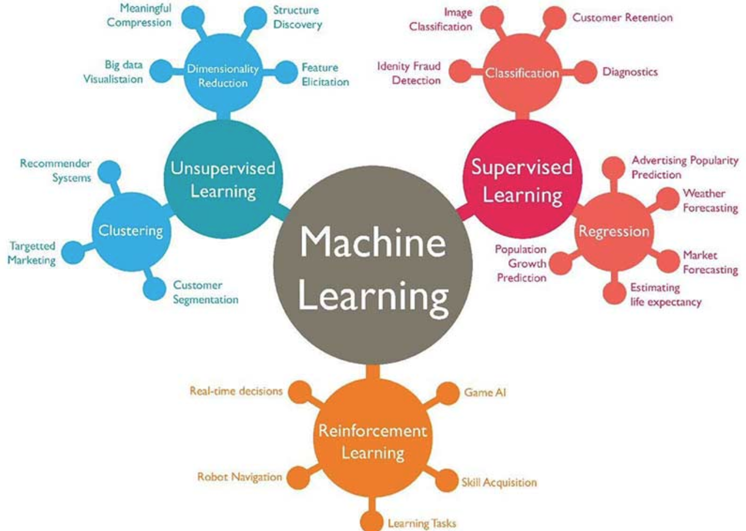
Learning Approaches

Slide 21
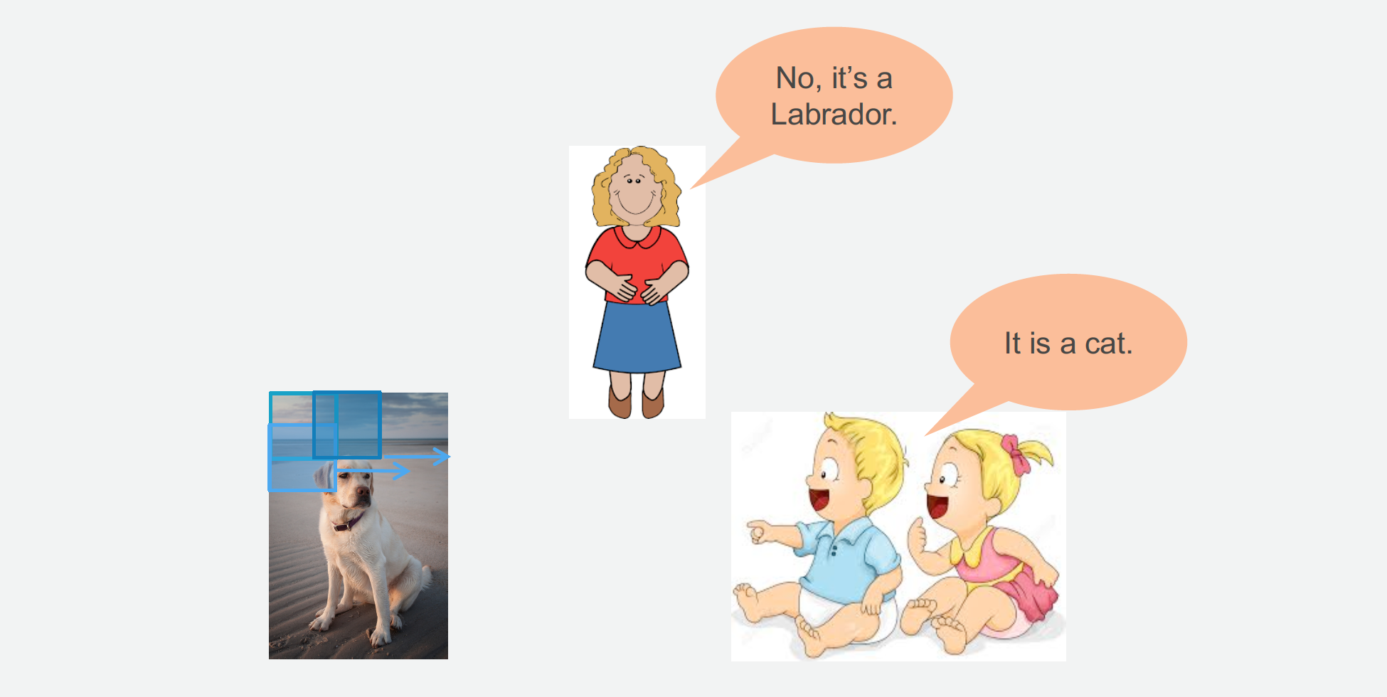
Supervised Learning

Slide 22
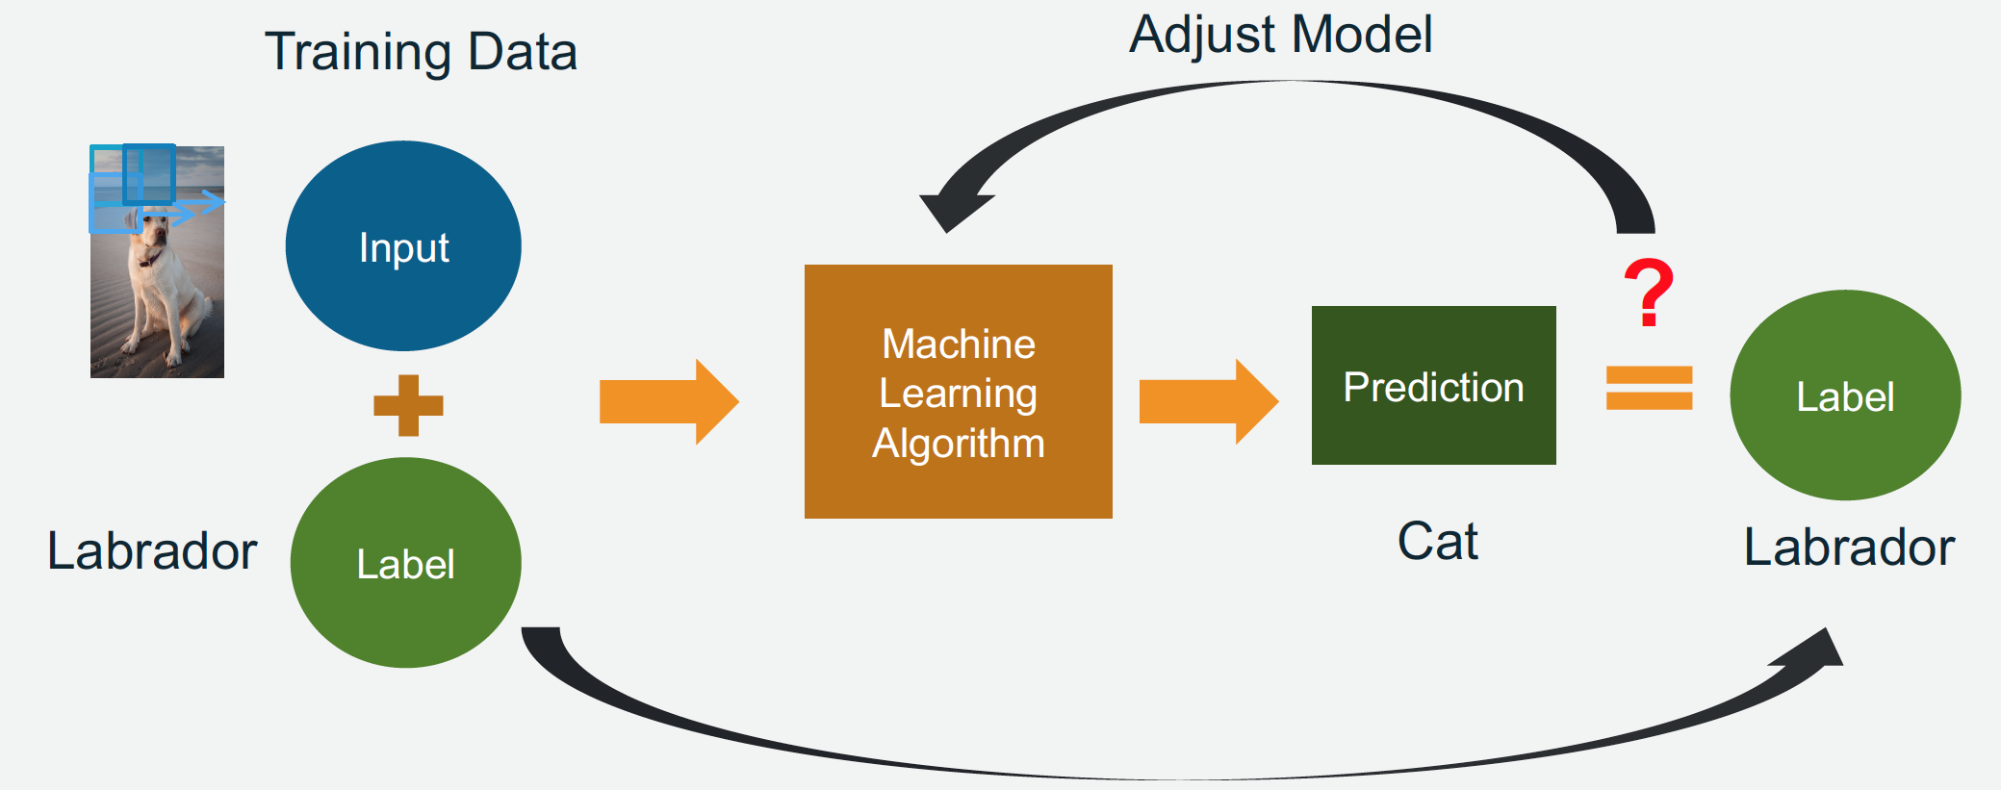
Supervised Learning

Slide 23
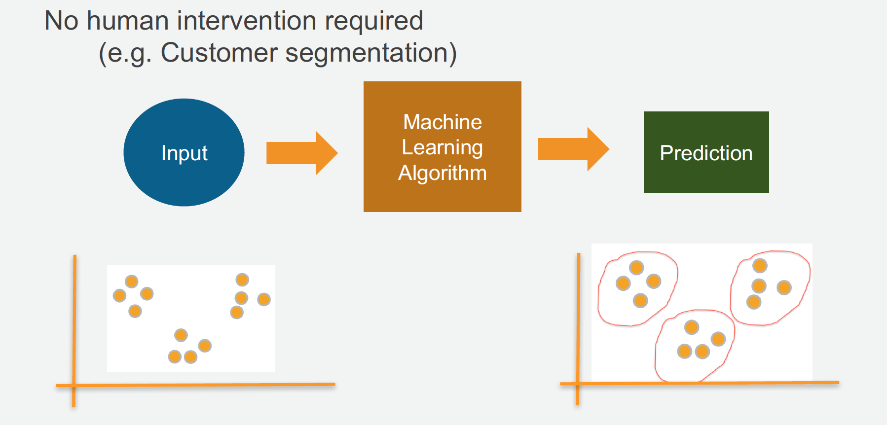
Unsupervised Learning

Slide 24
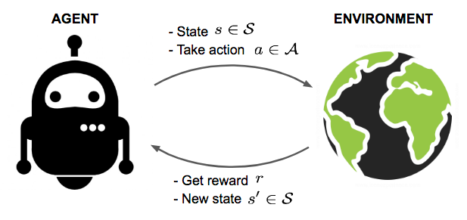
Reinforcement Learning

Slide 25
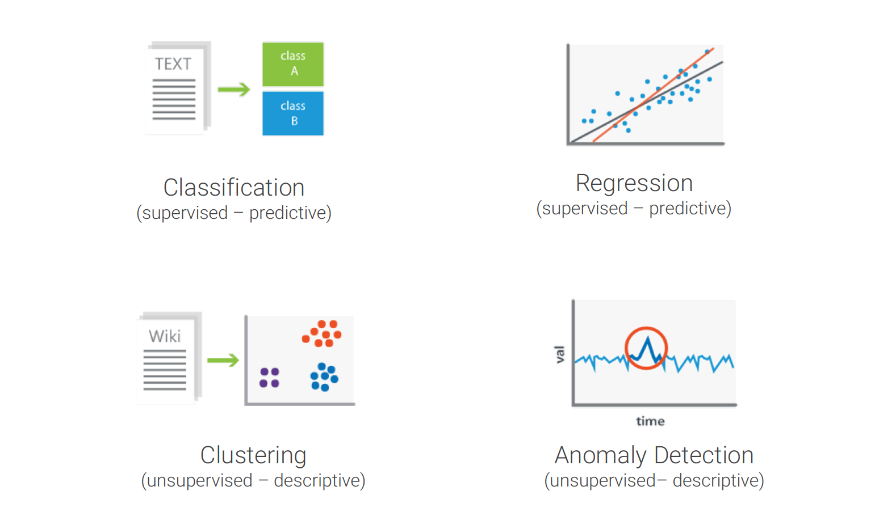
Problem Types

Slide 26
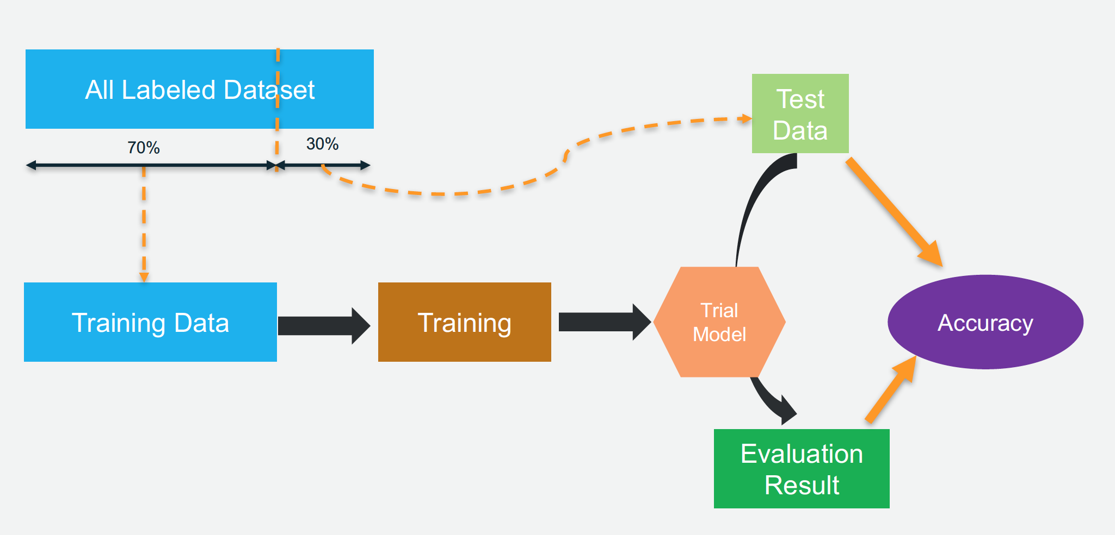
Model Training

Slide 27
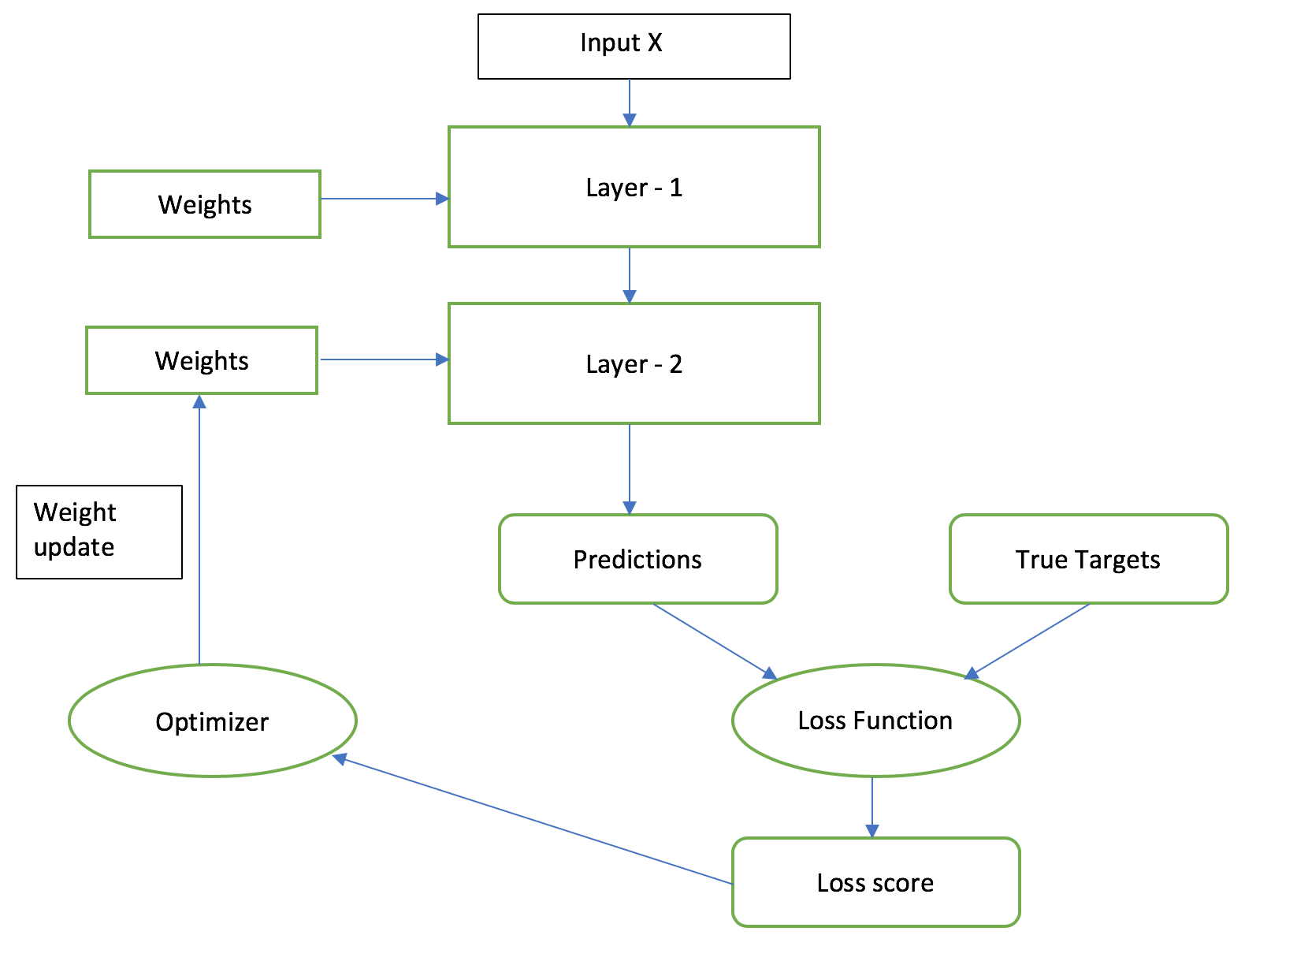
Model Training

Slide 28
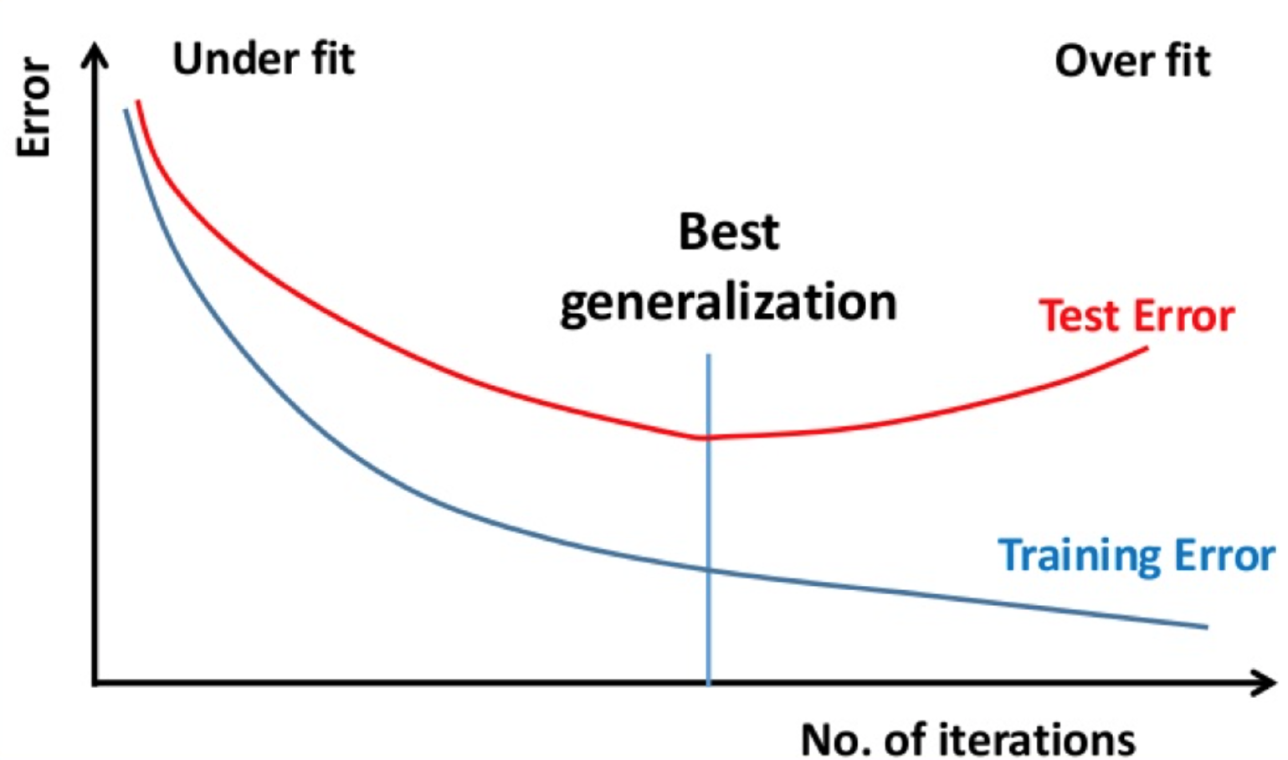
Underfitting/Overfitting

Slide 29
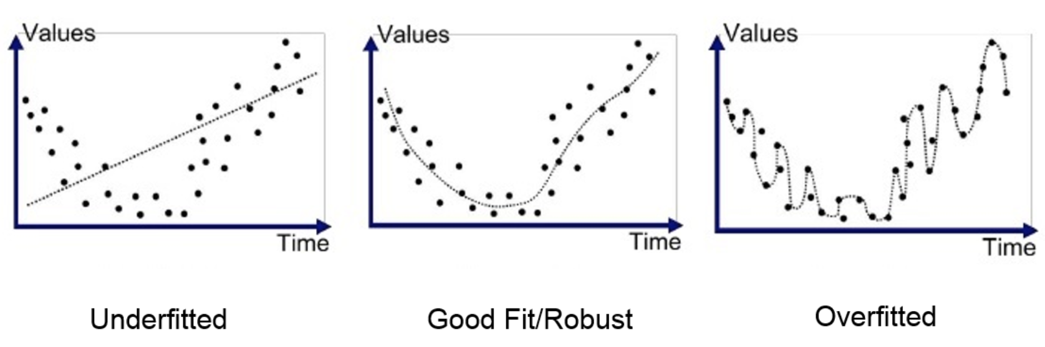
Underfitting/Overfitting

Slide 30
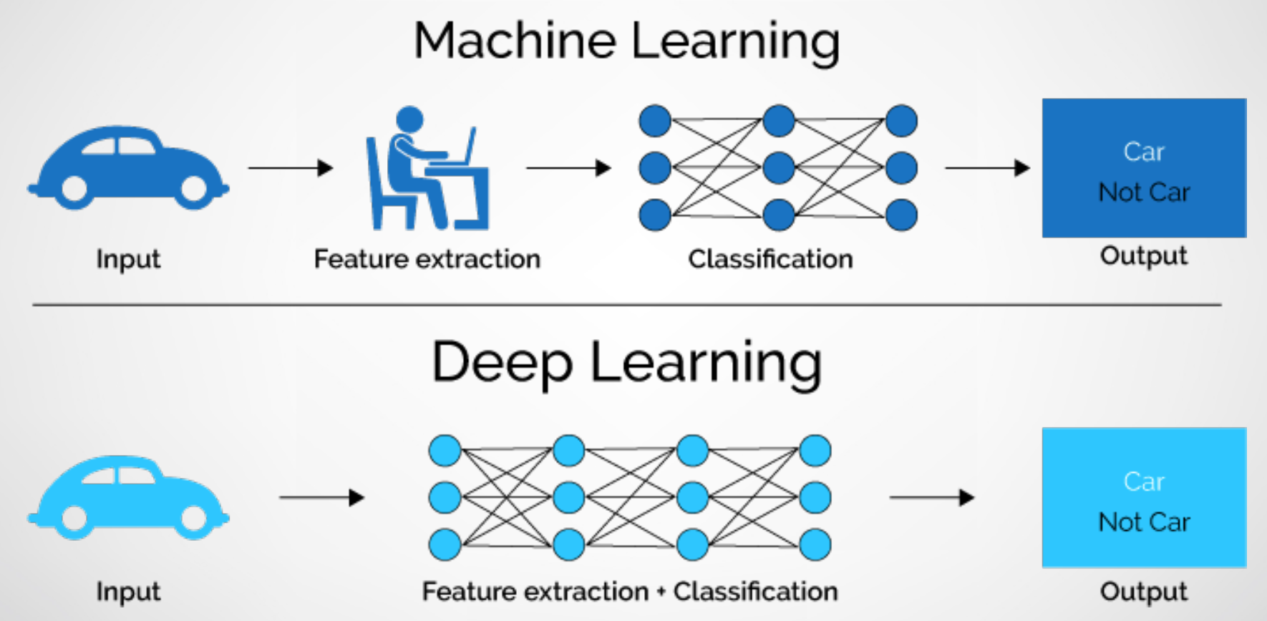
Deep Learning

Slide 31
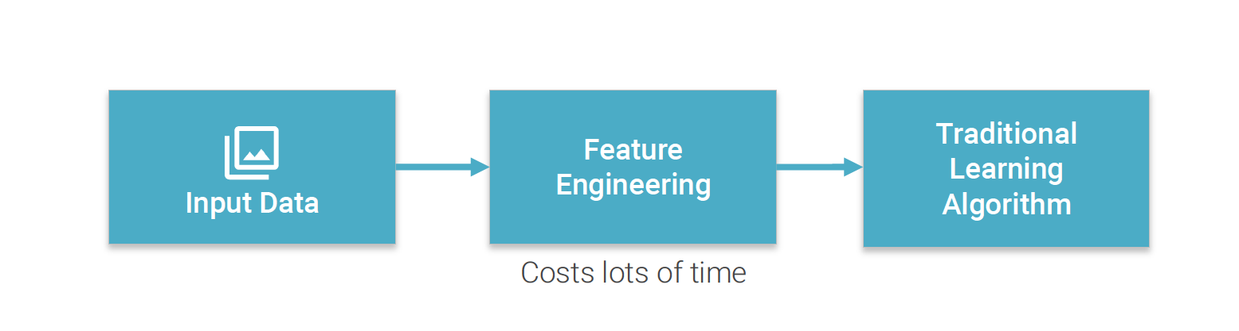
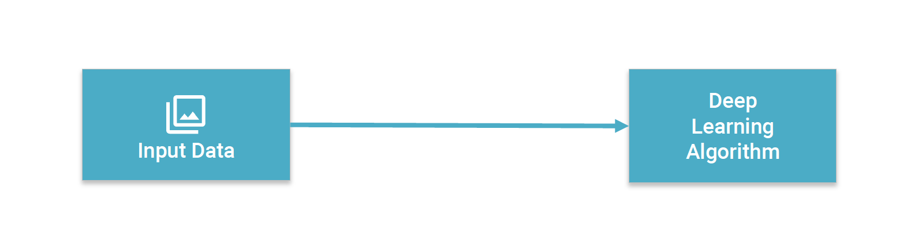
No More Feature Engineering

Slide 32
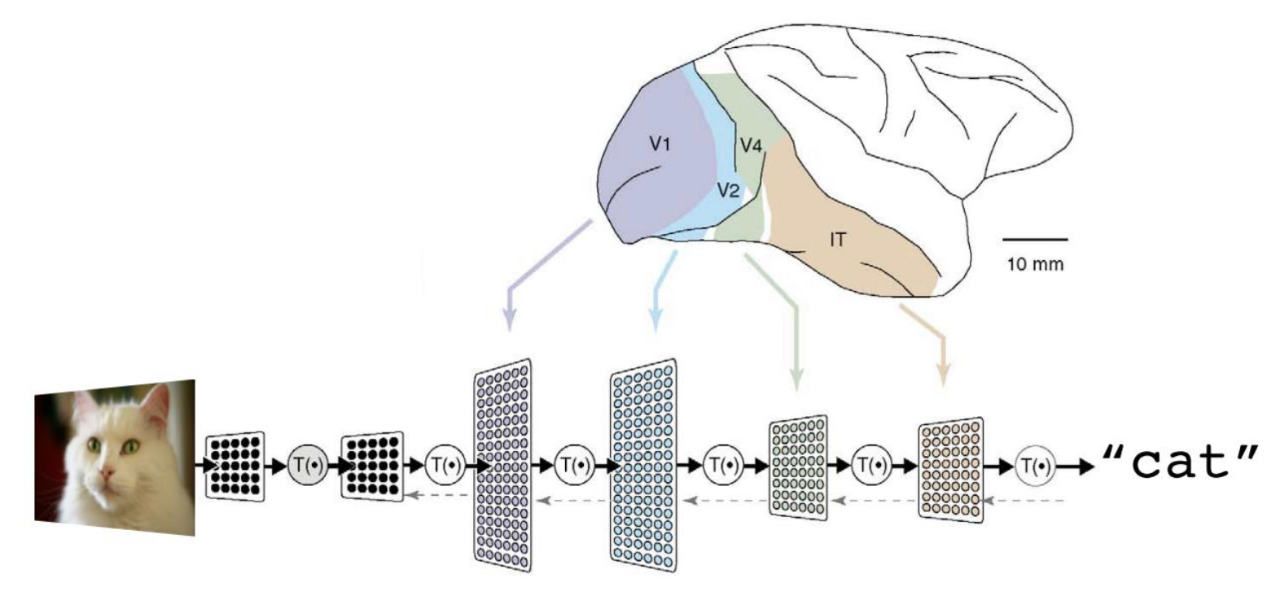
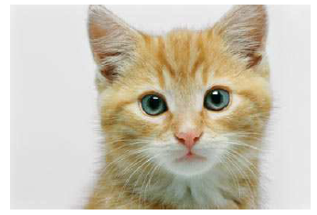
Deep Learning - Architecture
In 1958, David Hubble and Torsten Wiesel worked on the visual cortex of cats.
They realized that some groups of cells are activated when they detect an edge oriented with a certain angle.

Slide 33
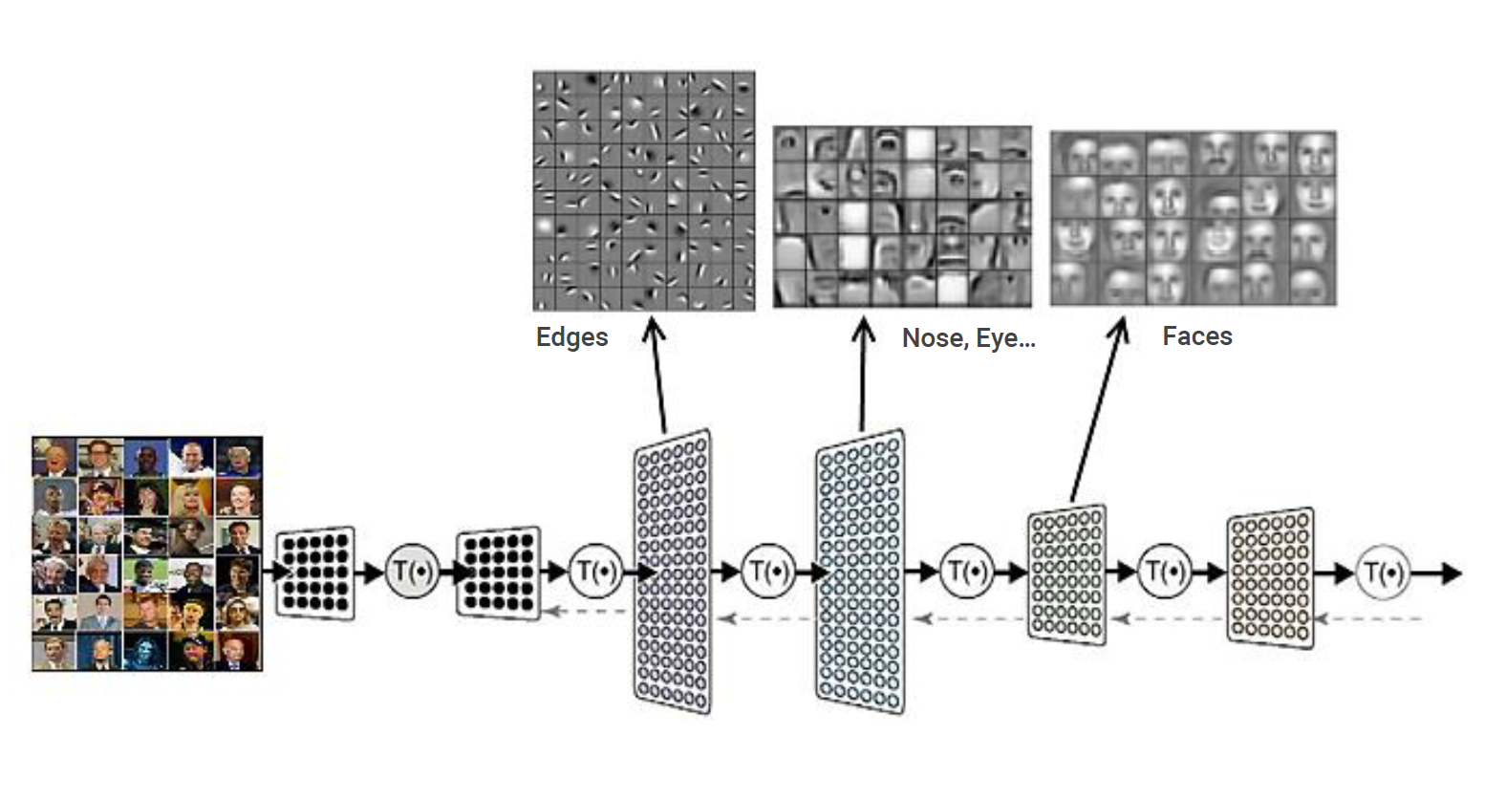
Deep Learning - Architecture

Slide 34
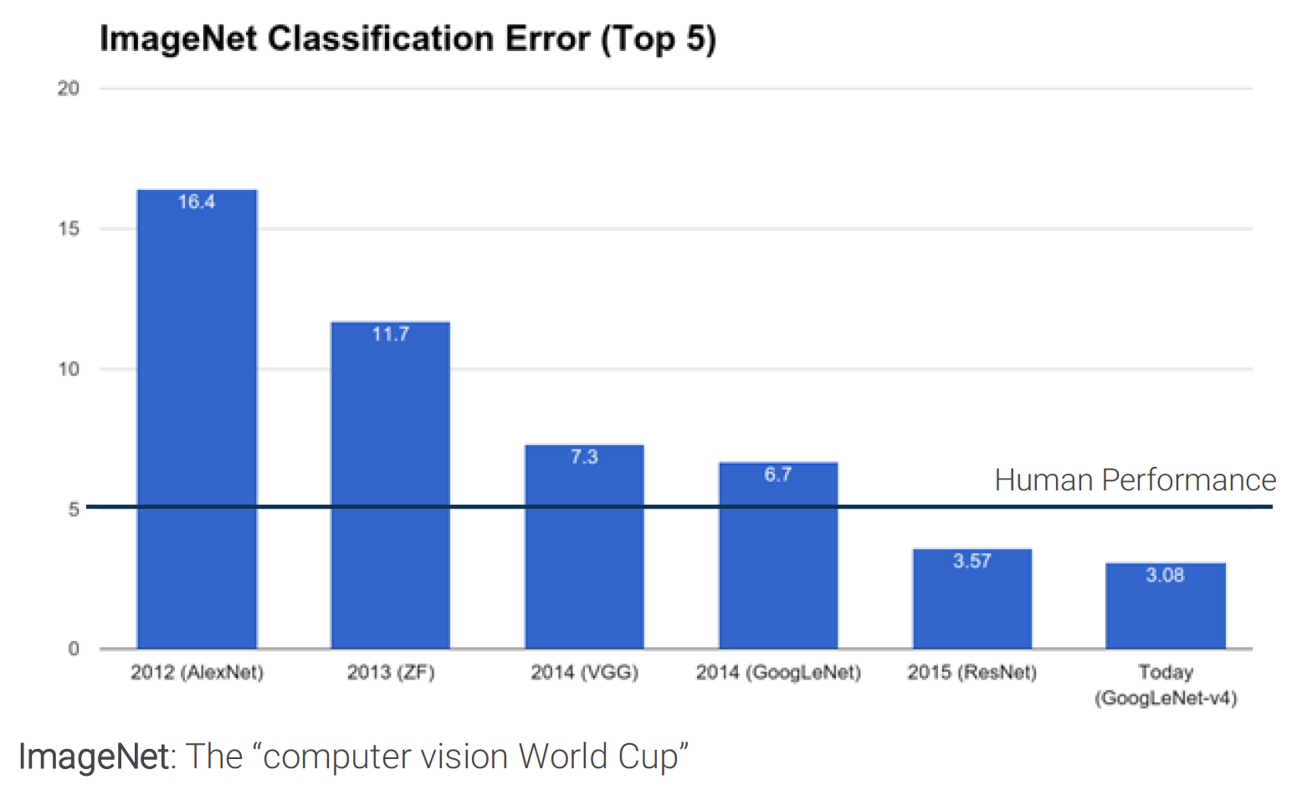
Deep Learning - Architecture

Slide 35
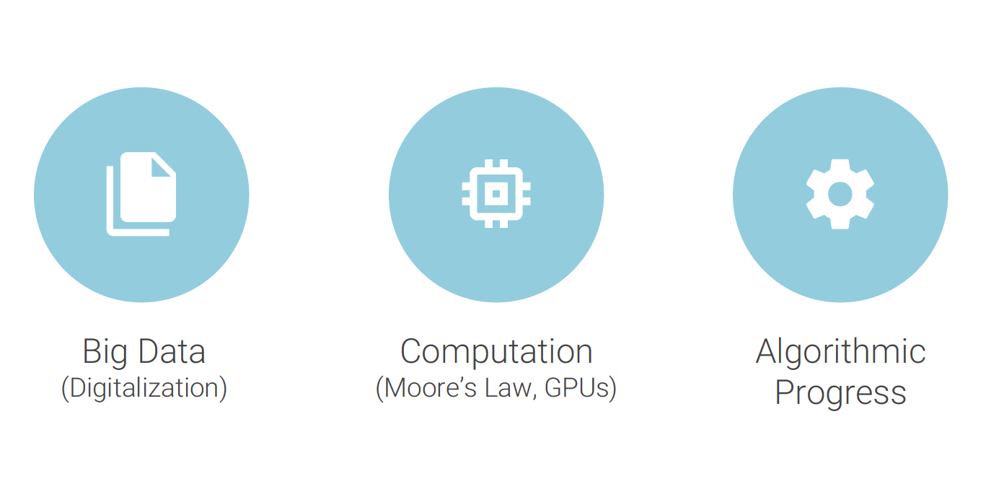
What changed?

Slide 36
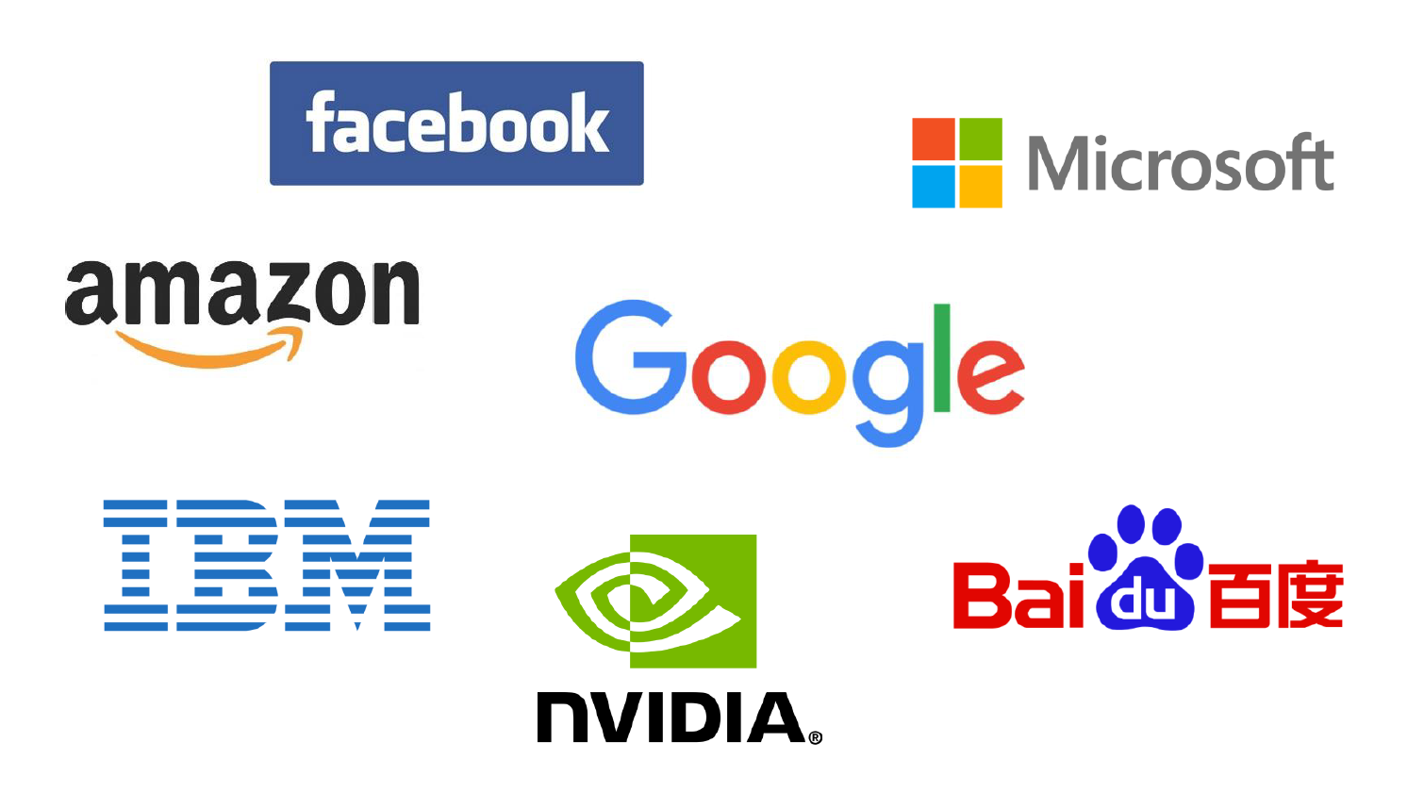
The Big Players

Slide 37
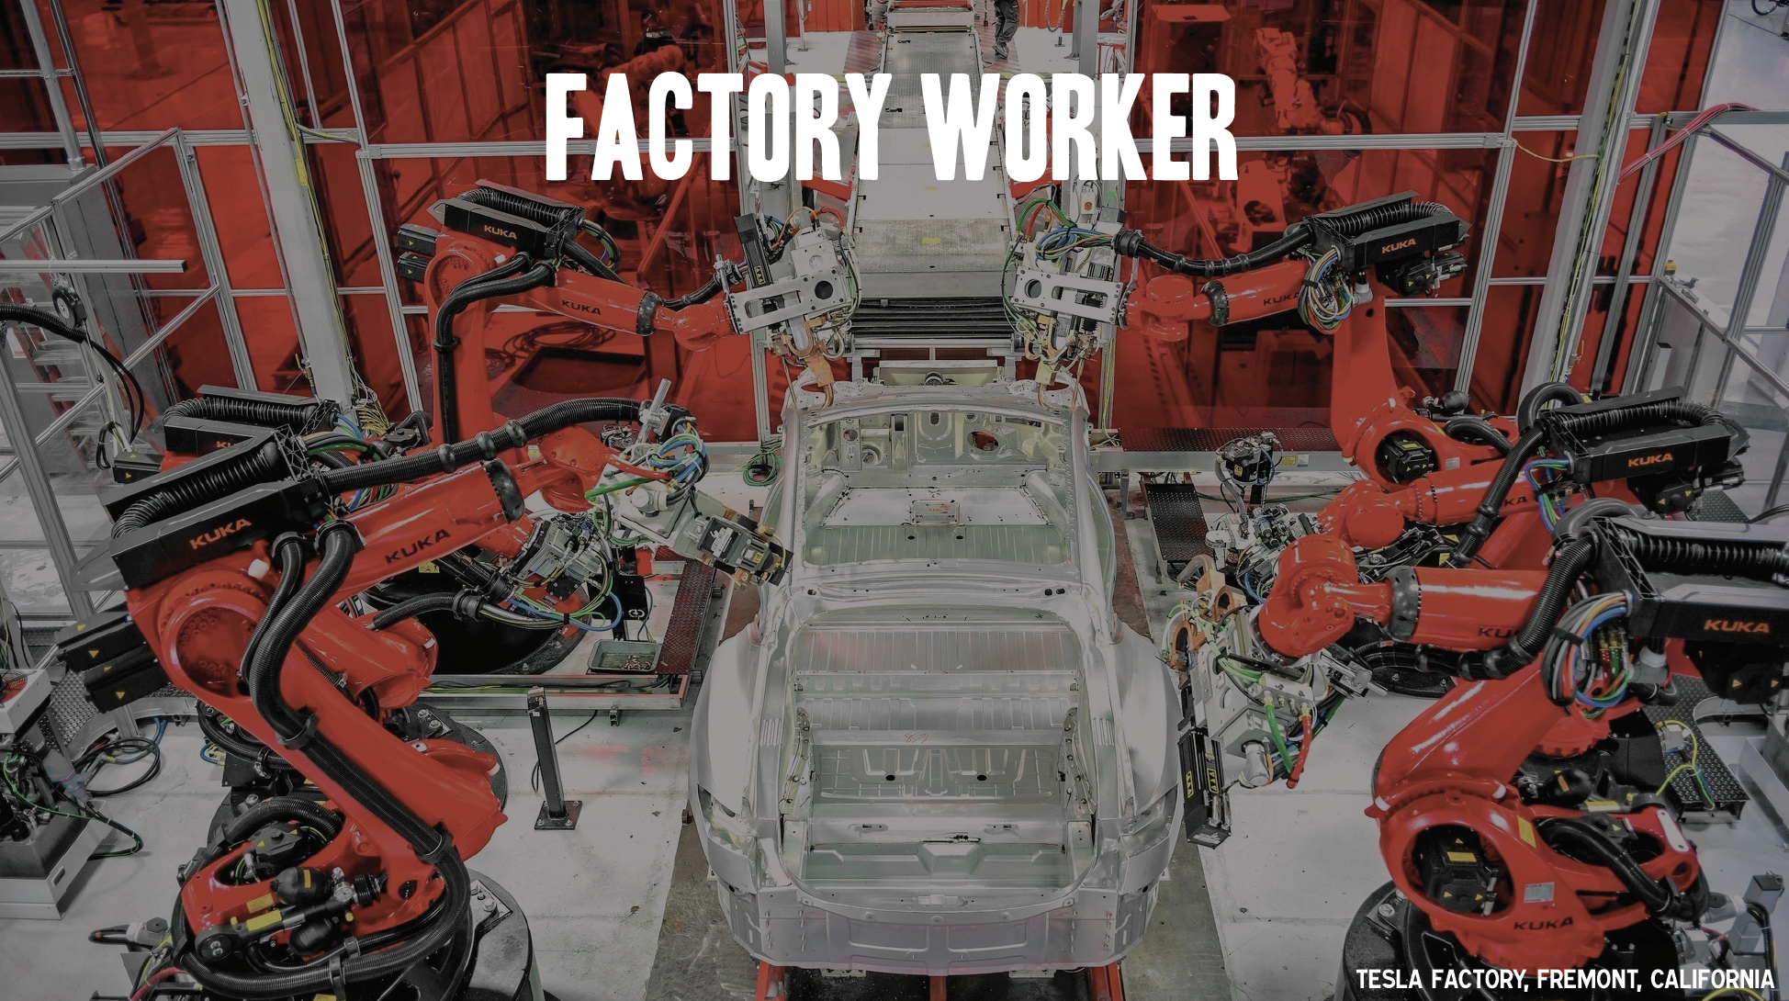
The Machines are Coming

Slide 38
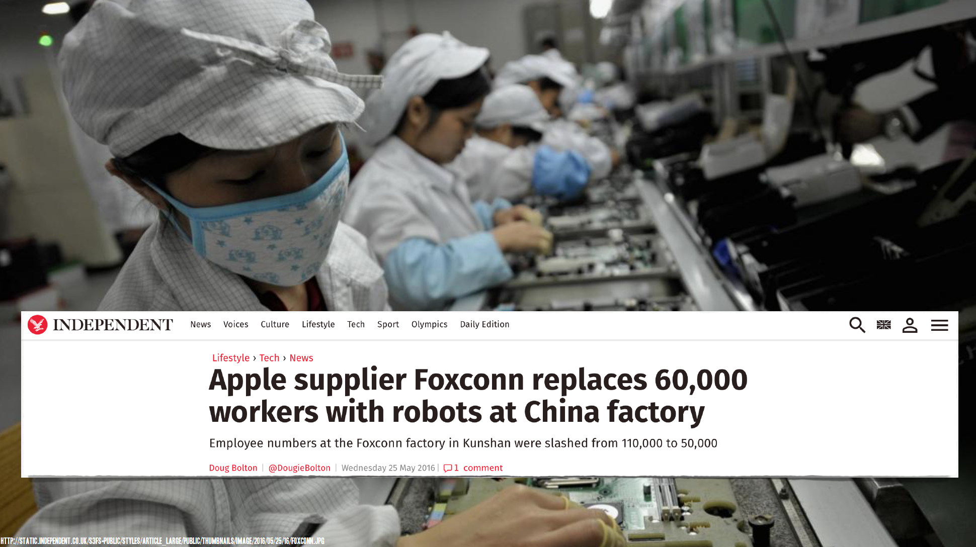
The Machines are Coming

Slide 39
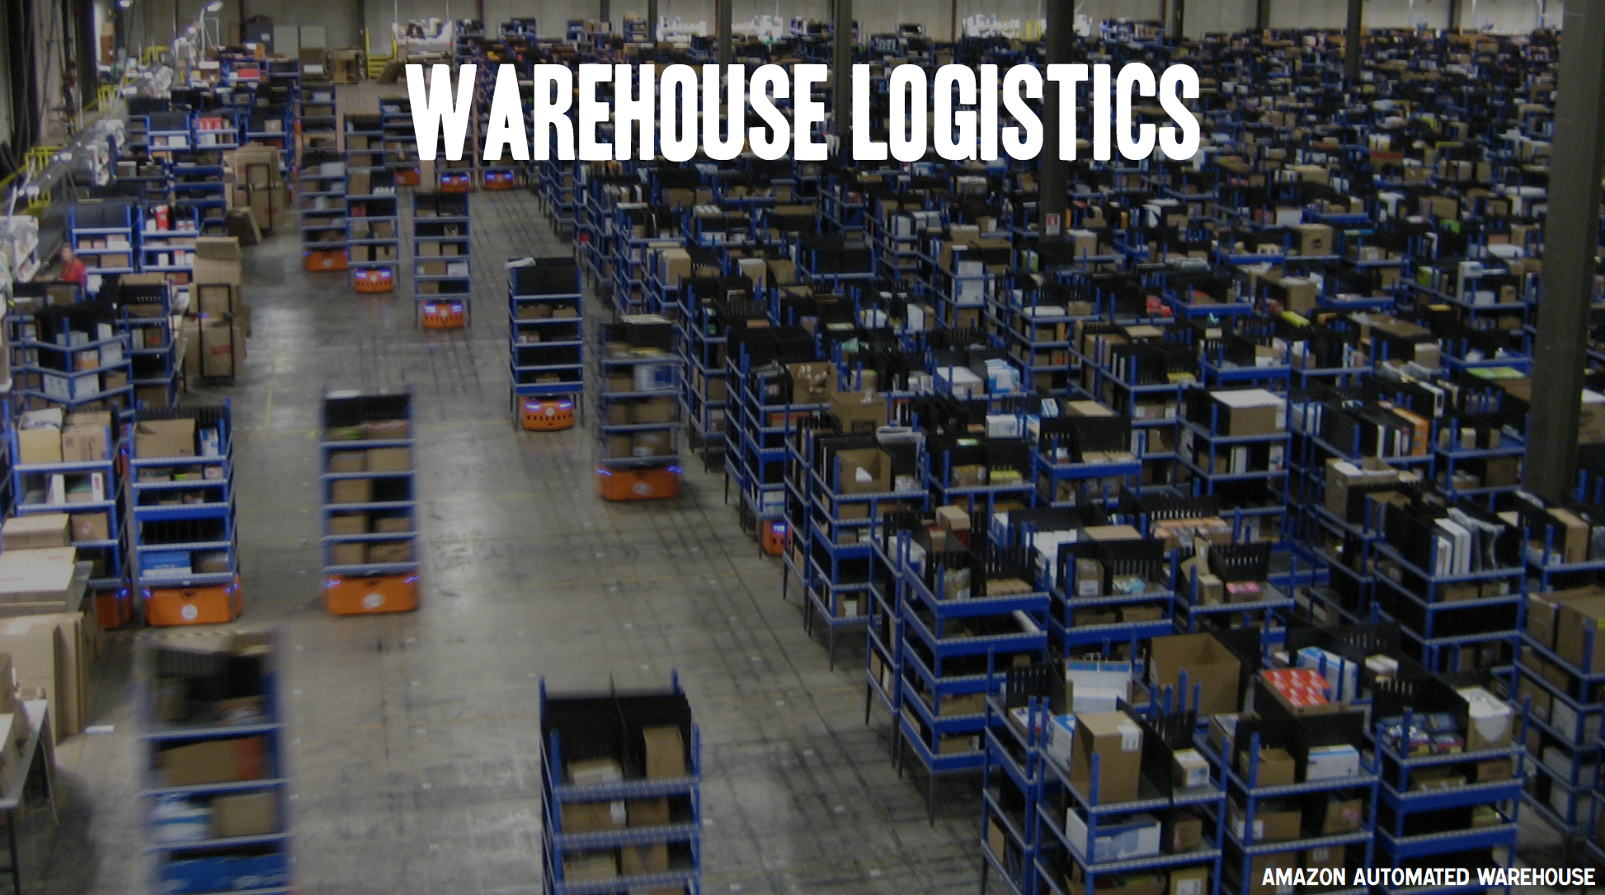
The Machines are Coming

Slide 40
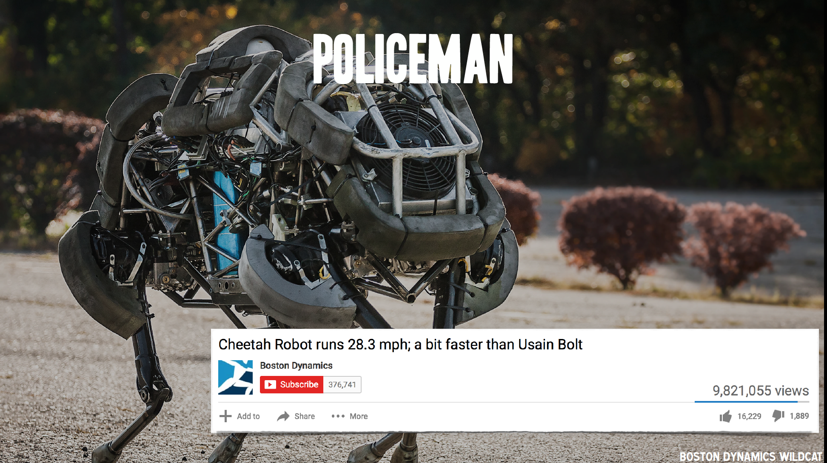
The Machines are Coming

Slide 41
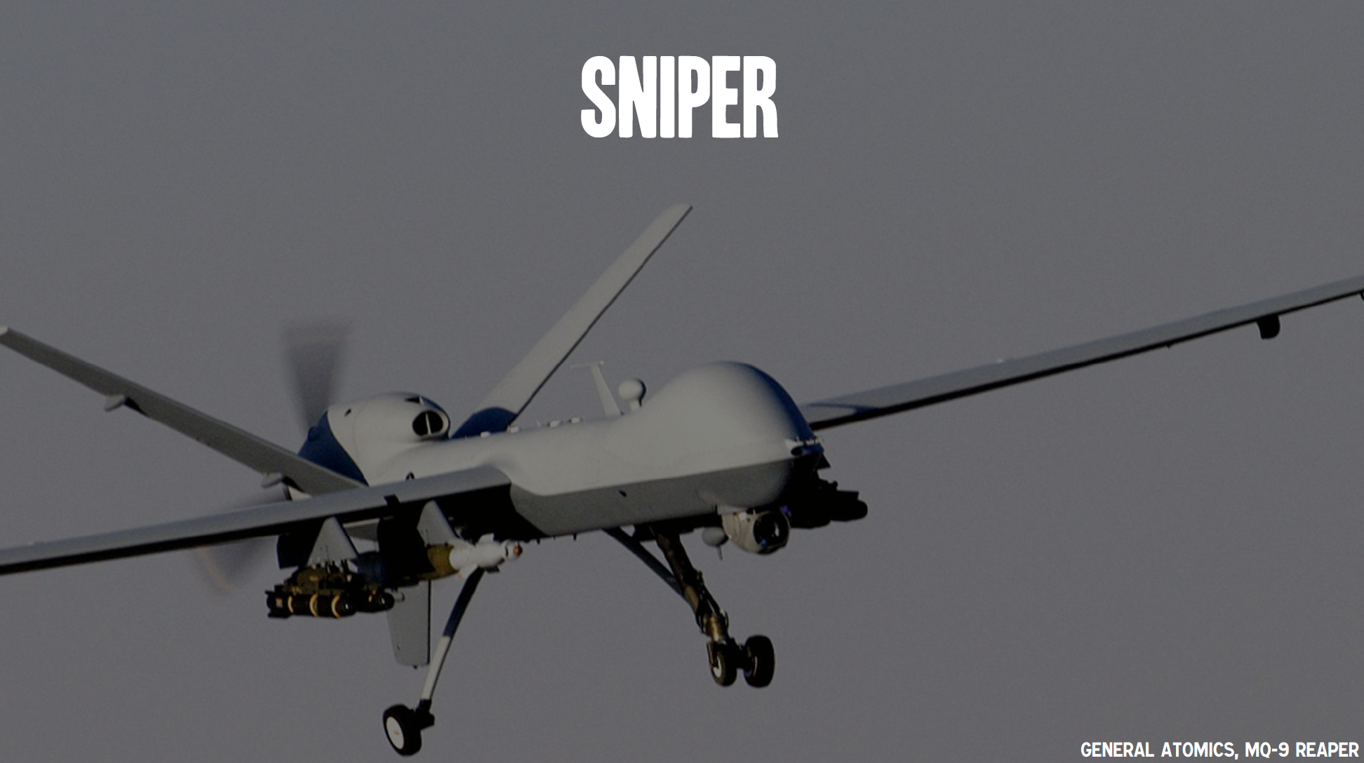
The Machines are Coming

Slide 42

The Machines are Coming

Slide 43
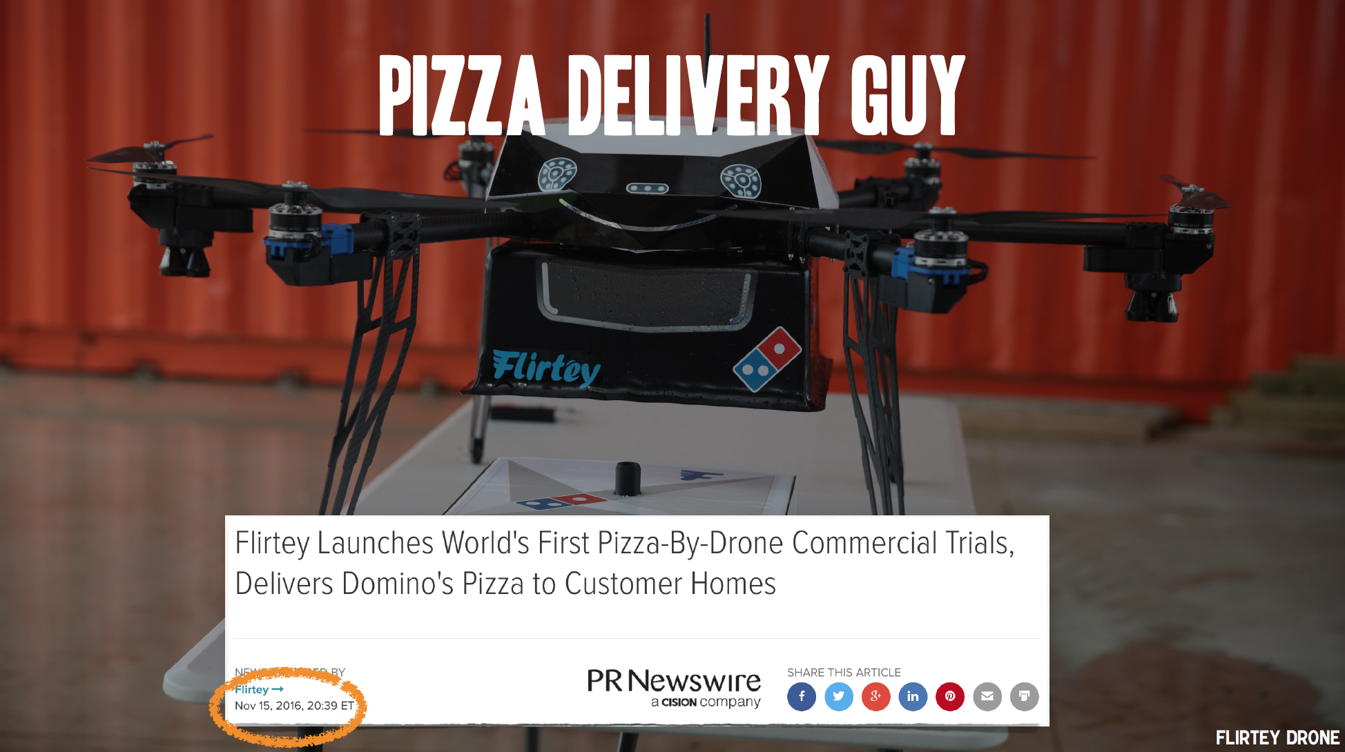
The Machines are Coming

Slide 44
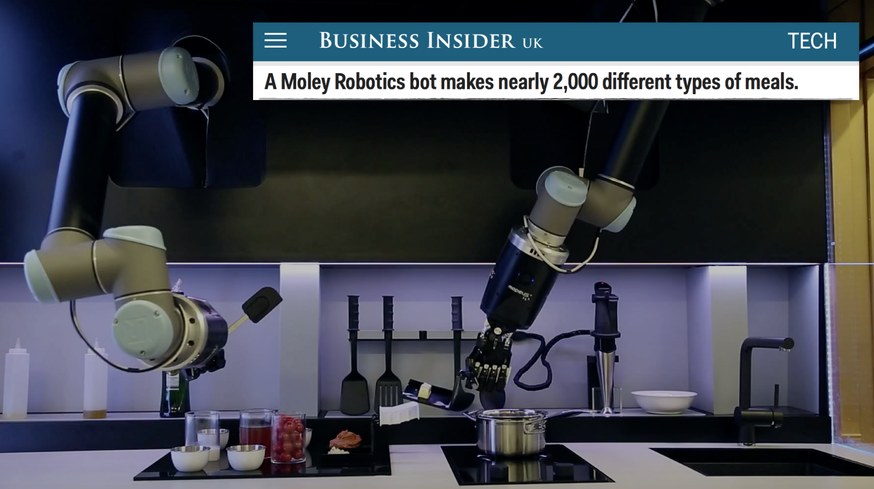
The Machines are Coming

Slide 45
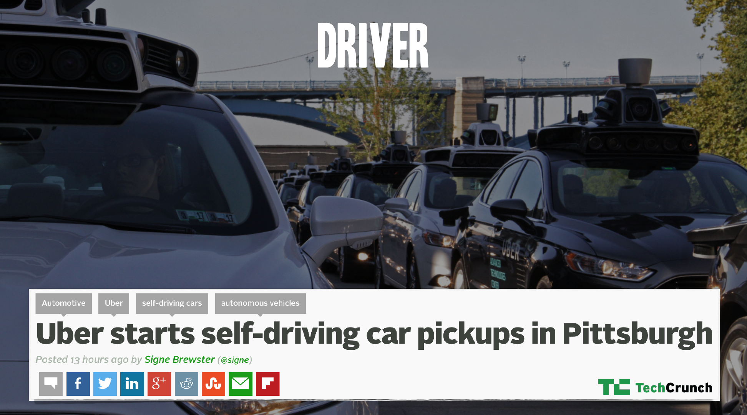
The Machines are Coming

Slide 46
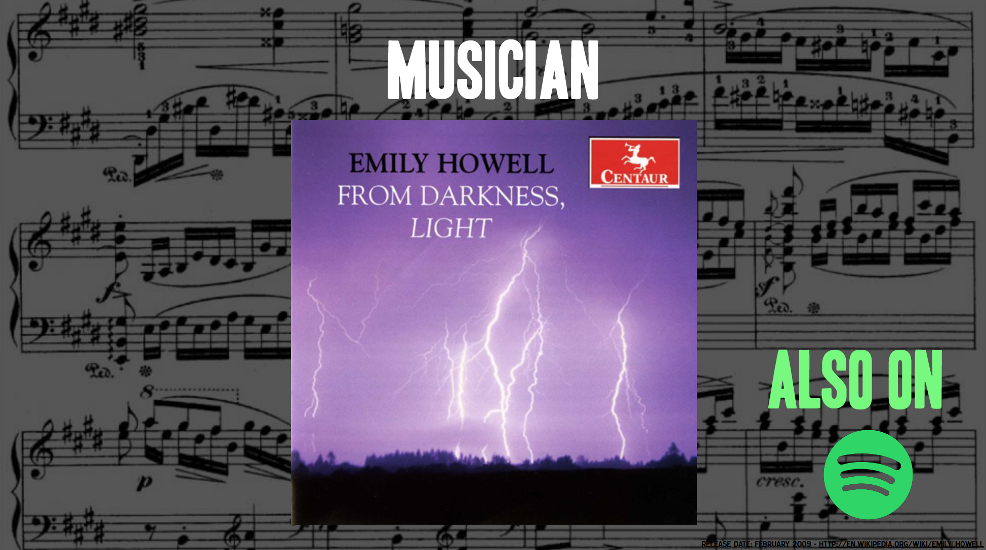
The Machines are Coming

Slide 47
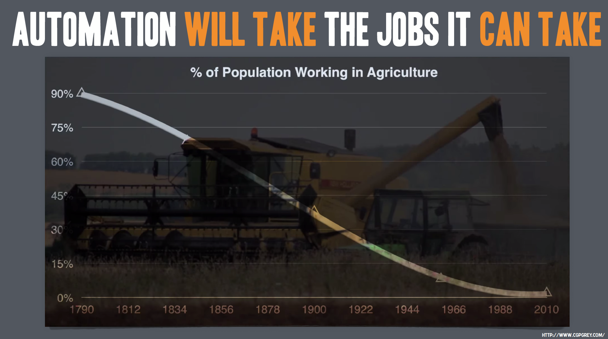
The Machines are Coming

Slide 48
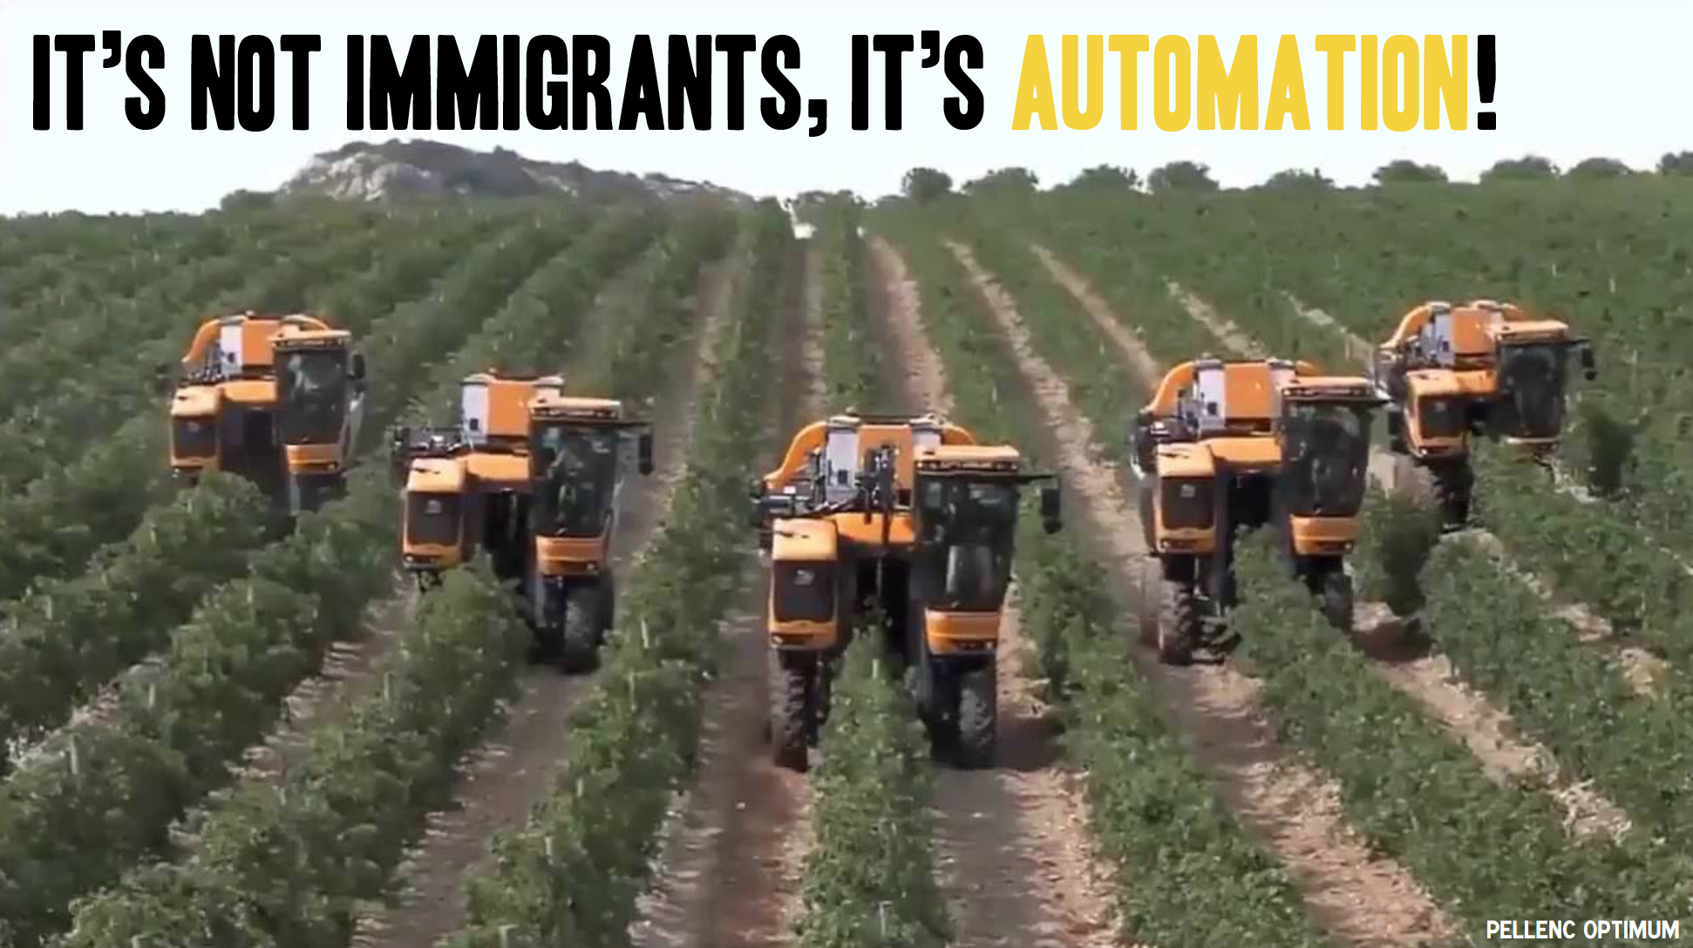
The Machines are Coming

Slide 49
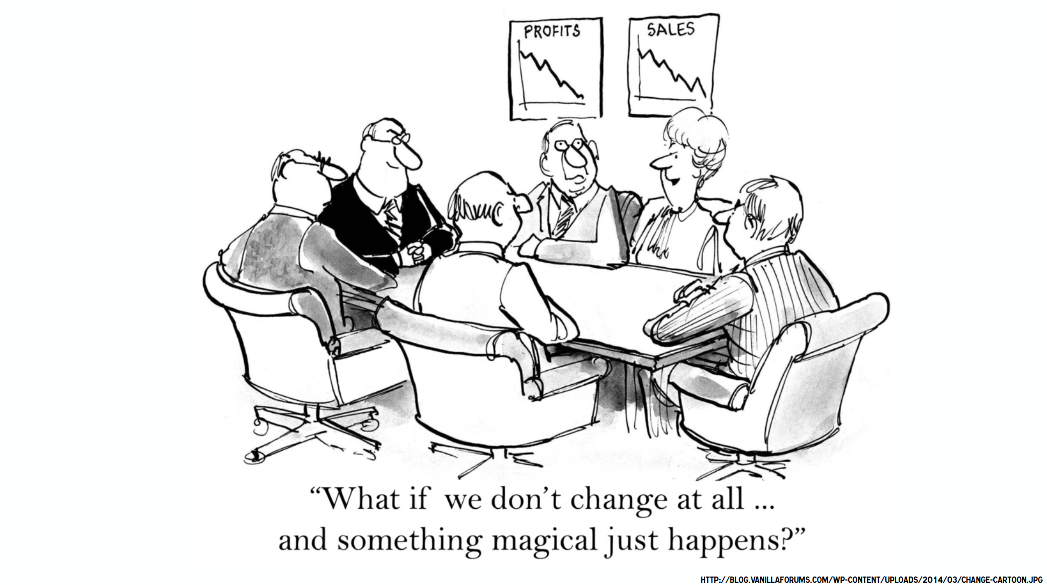
The Machines are Coming

Slide 50
References
https://medium.freecodecamp.org/an-intuitive-guide-to-convolutional-neural-networks-260c2de0a050
https://machinelearningmastery.com/supervised-and-unsupervised-machine-learning-algorithms/
https://readwrite.com/2018/07/19/5-forecasts-about-the-future-of-machine-learning/
https://www.capterra.com/machine-learning-software/
https://www.slideshare.net/hirsch30/tedx-manchester-ai-the-future-of-work-72337997?ref=https://www.analyticsindiamag.com/popular-presentations-on-artificial-intelligence-and-machine-learning/
https://www.slideshare.net/LuMa921/deep-learning-the-past-present-and-future-of-artificial-intelligence?ref=https://www.analyticsindiamag.com/popular-presentations-on-artificial-intelligence-and-machine-learning/
https://medium.com/bursa-i-o/derin-%C3%B6%C4%9Frenme-ve-makine-%C3%B6%C4%9Frenimi-farklar%C4%B1-84c63bbc6bfb
https://www.forbes.com/sites/louiscolumbus/2018/01/12/10-charts-that-will-change-your-perspective-on-artificial-intelligences-growth/#110011844758
https://www.forbes.com/sites/louiscolumbus/2018/02/18/roundup-of-machine-learning-forecasts-and-market-estimates-2018/#7e307d2d2225

Slide 51


github.com/batux
batuhanduzgun
Thank you!
Questions?

